Slide 1
Altimeters
Team 7:
K. Christian M. Jones
R. Lupinski I. McCall
T. Thomas

Slide 2
Overview
Introduction
Types of Altimeters
  Applications
Barometric Altimeters
    Advantages/Disadvantages
Our Project
  A Peek Inside Our Altimeter
  ATD Conversion
  The Bigger Picture
Notes:
KC

Slide 3
Introduction
What is an altimeter?
Altimetry
  (Latin: altus- , “height”)
  +
  (Greek: -metron, “measurement”)
Instrument/Device that measures height or altitude, from a fixed level (usually the ground)
Notes:
KC

Slide 4

What’s the significance?

Slide 5

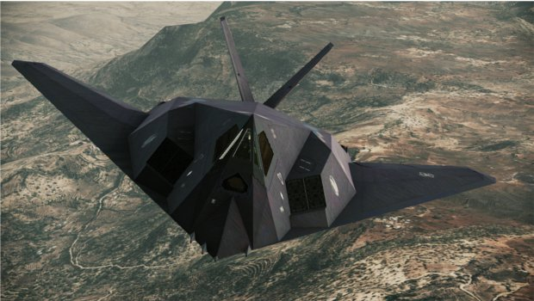
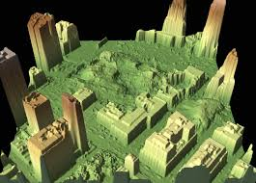

Common Applications
Notes:
KC
Cockpit – most important device pilot reads
Fighter Jet – uses radar altimeter in regards to stealth missions
Mapping and surveying landscapes
Altimeters used to combat “Altitude Sickness”

Slide 6
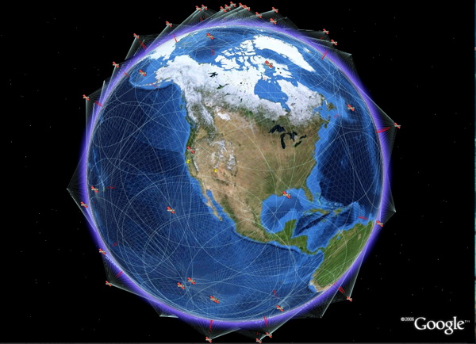
Altimeter Types: GPS
Global Positioning System
Notes:
MJ
Determine altitude by trilateration (determine absolute/relative locations) using 4 or more satellites

Slide 7
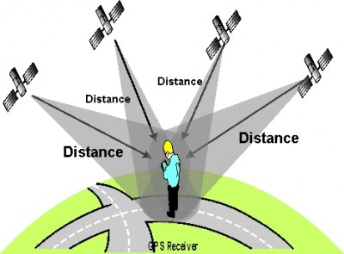
GPS Trilateration

Slide 8
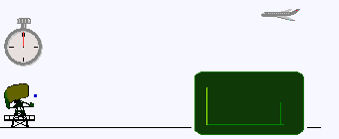
Altimeter Types:
Active Remote Sensing
RADAR
Radio waves transmitted to ground, reflection time determines altitude
Notes:
MJ
Radar developed during WWII
- Radio Waves emitted and since we know the speed at which the radio waves are traveling, we can determine the distance from the source by the time it takes to reflect back.
LiDAR invented in 1960s
-Combines a laser’s focus with radar’s concepts of measuring reflection time

Slide 9
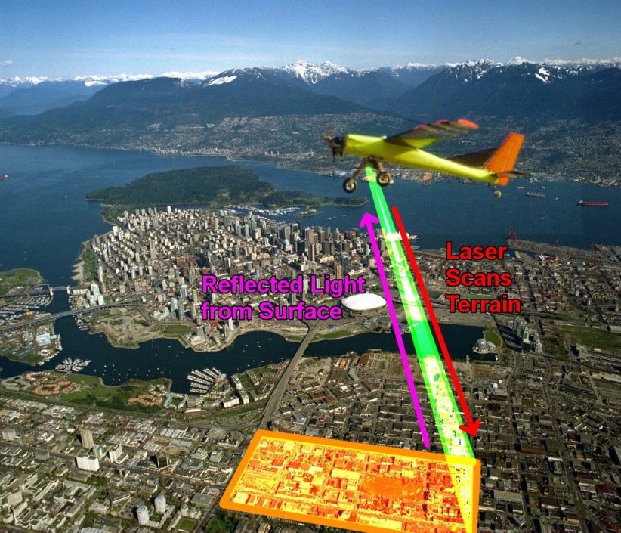
Active Remote Sensing:
LiDAR
Light Distancing
And Ranging
Combines a laser’s focus with radar distancing
Laser adds detailed scanning

Slide 10
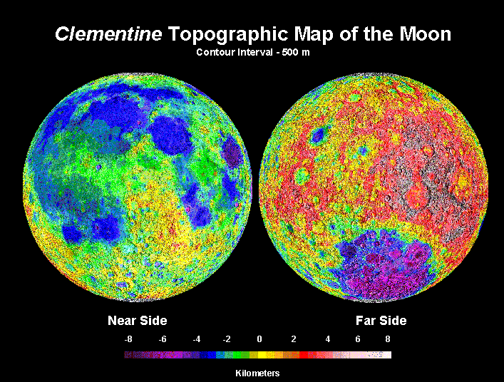
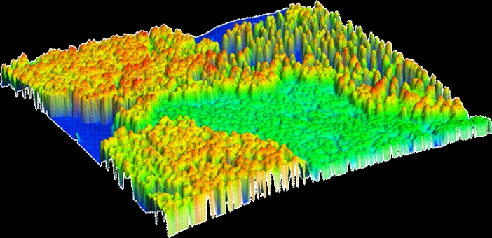
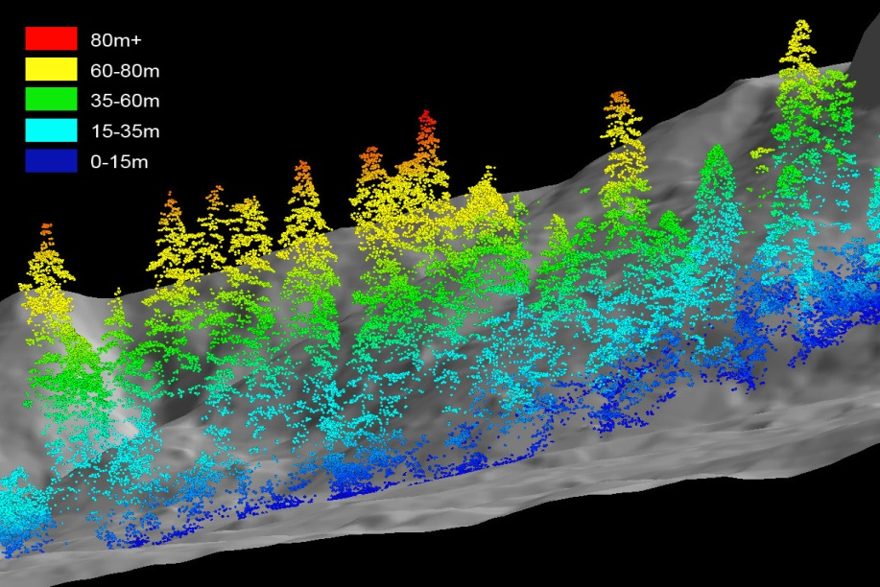
LiDAR Applications
Notes:
MJ
LiDAR used extensively in atmospheric research & meteorology, surveying & mapping, space missions (Apollo 15 used LiDAR to map the moon’s surface)
Forestry

Slide 11
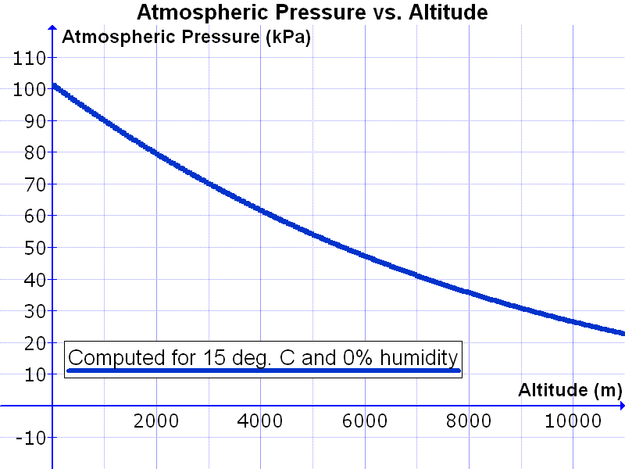
Barometric
Measures altitude by means of measuring air pressure
Relationship between altitude & air pressure
Notes:
MJ

Slide 12

Disadvantages
Radar
FCC
Requires extra licensing
Actively transmitting on FCC frequencies
  $10,000 fines
  1 year imprisonment
Notes:
Independent – GPS depends on several satellites to triangulate position
- With a barometer, all we will need is a constant (Air Pressure)
- Will be able to sense changes in air pressure regardless of direction
- LiDAR would require a downward facing sensor (that’s where our ejection charges are)
Cheaper

Slide 13
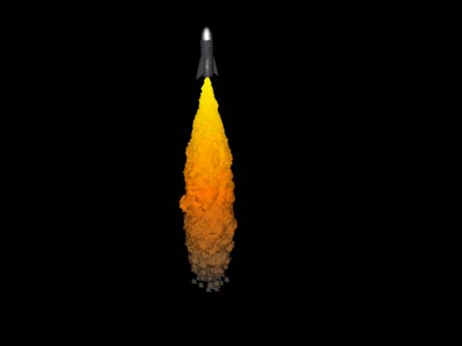
Disadvantages
LiDAR
Expensive
Location on our rocket?
  Needs to point down
Notes:
Independent – GPS depends on several satellites to triangulate position
- With a barometer, all we will need is a constant (Air Pressure)
- Will be able to sense changes in air pressure regardless of direction
- LiDAR would require a downward facing sensor (that’s where our ejection charges are)
Cheaper

Slide 14
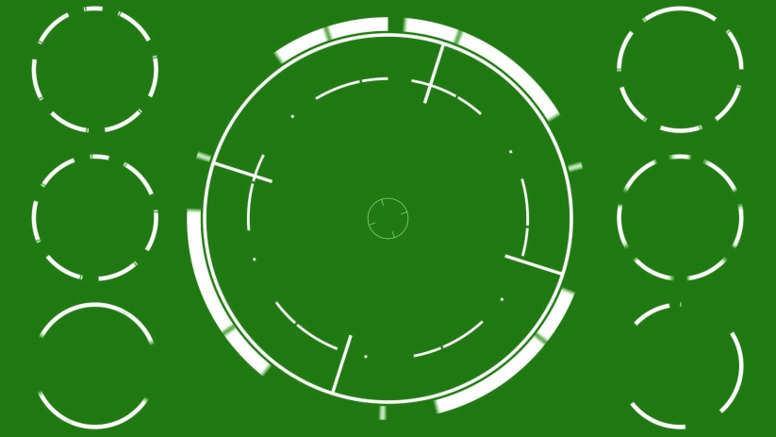
Disadvantages
GPS
Real-time measurement confinements
  Governmental
  Target’s Acceleration
Generally less accurate than barometric
?

Slide 15
Why barometric?
Advantages
Drawback
Independence
Accuracy
Cheap
Ease of implementation
Recalibration with varying temperature
Notes:
Independent – GPS depends on several satellites to triangulate position
- With a barometer, all we will need is a constant (Air Pressure)
- Will be able to sense changes in air pressure regardless of direction
- LiDAR would require a downward facing sensor (that’s where our ejection charges are)
Cheaper

Slide 16
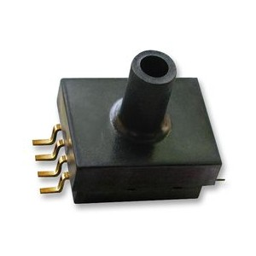
MPXM2102 Altimeter
Piezoresistive sensor
Differential pressure & linear voltage output
Silicon diaphragm with strain gauge
Sensitivity ratio metric to supply voltage.
Notes:
RL

Slide 17
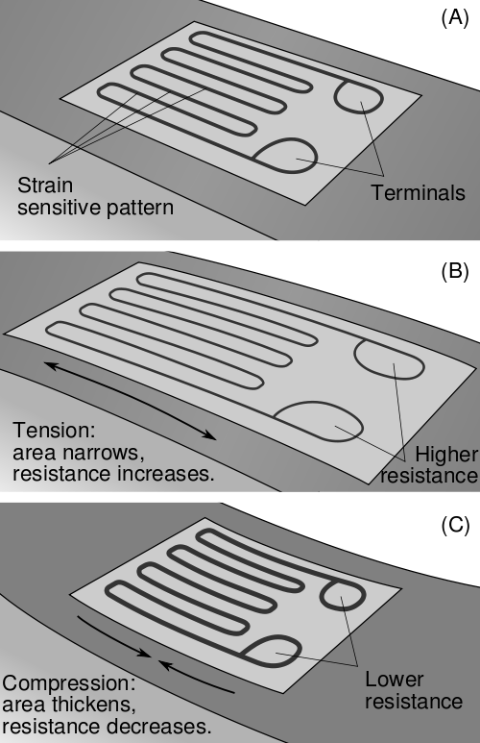
Piezoresistive Sensor
Silicon diaphragm connected to pressure side and vacuum side.
Change in shape of thin-film resistor changes resistivity
Resistance changes output voltage
Notes:
RL

Slide 18
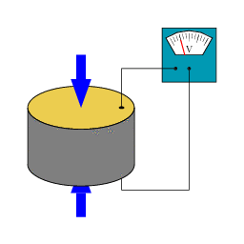
Pressure As a Voltage
Increasing pressure on atmospheric side relative to vacuum side increases voltage and vice versa
Notes:
RL

Slide 19
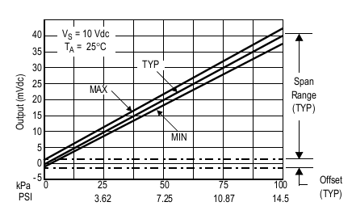
Differential output & linearity
Ratio metric:
  10V source = 40mV Span
  3.3V/10V * 40mV = 13.2mV span
Sensitivity ΔV/ΔP
Taking the difference of voltage from atmospheric to vacuum side give voltage corresponding to altitude
Output w/ Vs = 10V
Notes:
RL

Slide 20
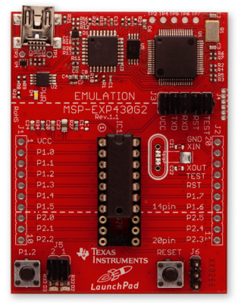
ADC via MSP430
Using the MSP430, analog voltage readings from the altimeter can be stored and referenced
These readings can then be compared to a pre-set level
  Must determine average output voltage for said level
  Once MSP430 sees a match, toggles an output pin, and main parachute deploys
Notes:
IM

Slide 21
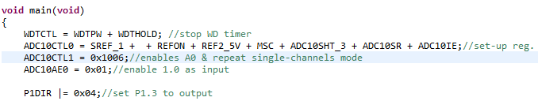
Example ADC code
Similar to in-class Labs
Set up ADC10CTL0
  For ISR, sampling rate, and reference voltage (among others)
Set up ADC10CTL1
  To enable analog input pin and repeat-single-channel
Notes:
IM

Slide 22
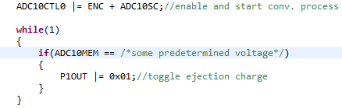
Example ADC code
Once ADC is activated, conversions results are stored in ADC10MEM
Use if statement in a while(1) loop for actual comparing of data
Notes:
IM

Slide 23
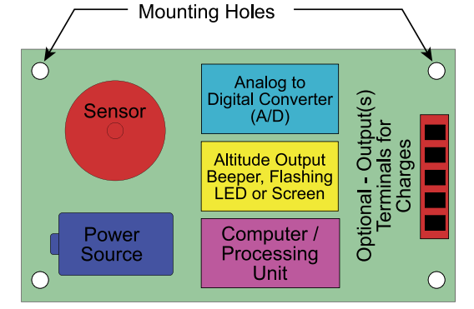
Block Diagram
Notes:
KC

Slide 24
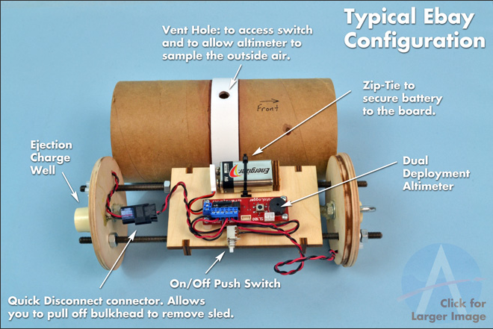
Electronics Bay (E-Bay)
Notes:
KC

Slide 25
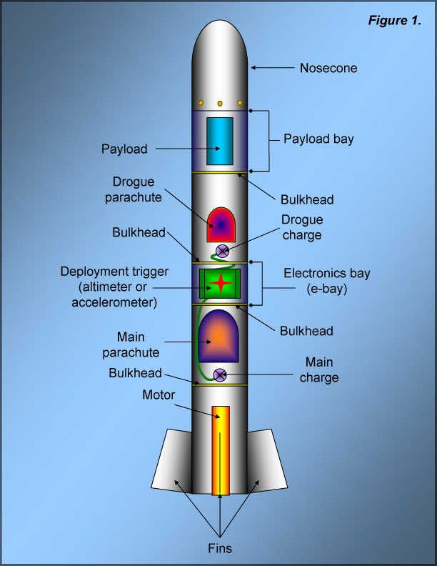
Final Product
DUAL PARACHUTE deployment system
  Altimeter deploys main parachute
  Has two stage parachute deployment system
  Incorporates electronic deployment trigger
Height: 4-15 feet
We will be using a G-class motor w/o ejection charge
Notes:
KC

